Slide 1
The Collaborative Problem Solving Approach: Making it work for kids on the spectrum
Diane Durante MEPD, OTR, CST I
Presentation modified from and based on the work of
Stuart Ablon, Ph.D. & Ross Greene, Ph.D.
for the Central Wisconsin Autism Society
November 4, 2010

Slide 2
Kids do well if they can…
…if they can’t, we adults need
to figure out why, so we can help

Slide 3
Overview
Kids do well if they can…philosophy
Characteristics: inflexible, explosive children
Why what we have tried may not be working
Can’t vs. Won’t and behavior (a new perspective)
Thinking Skills Inventory
The three Plans (A, B, C)
Implementing Plan B
Putting it all together
Questions and Answers

Slide 4
Collaborative Problem Solving
Developed by Dr. Ross Greene and Dr. Stuart Ablon
Cognitive behavioral approach
Requires a change in mindset in how to work with children and youth presenting with challenging behaviors.
Focuses on how adults interact with children/youth to manage their behaviors

Slide 5
Goal of CPS
Improve the youth’s capacities for flexibility, frustration tolerance, communication, and self-regulation.
To decrease adversarial interactions between parents and youth.

Slide 6
Characteristics of Inflexible/Explosive Children/Youth
Very limited capacity for flexibility and adaptability.
Incoherent when severely frustrated.
Tendency think in a concrete, rigid, black-and-white manner.
Persistence of inflexibility and poor response to frustration despite a high level of intrinsic or extrinsic motivation.
Does this sound like your child?

Slide 7
Theoretical Basis for CPS
Children do well if they can
Not children do well if they want to
If they can’t do well, we adults need to figure out what’s getting in the way so we can help
Your explanation guides your intervention

Slide 8
What behavior programs are based on…
“We’ve been trained” to believe that bad behavior occurs as a product of passive, permissive, and/or inconsistent parenting (teaching).
Kids then learn that their challenging behavior is an effective way to getting something (attention) or escaping or avoiding something (work).

Slide 9
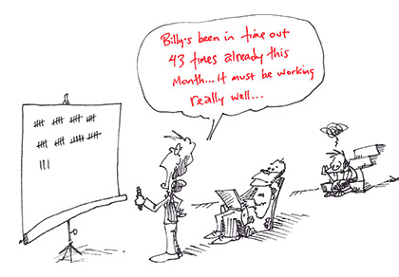
Logical intervention
“We then believe” that to “fix” the behavior we must “train” and “motivate” compliant behavior through intensive consistent programs of rewards, punishment, or ignoring.

Slide 10
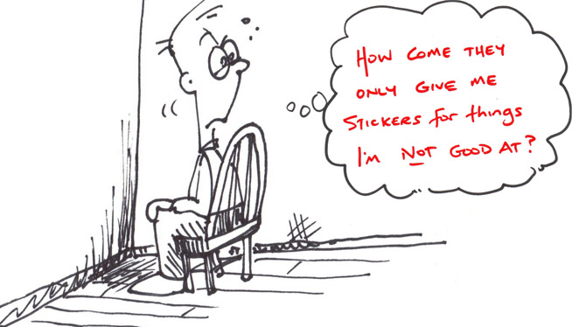
Do these sound familiar?
List of target behaviors
Menu of rewards and punishments
Currency system
Token Economy

Slide 11
Operant strategies
What they can do…
Teach basic lessons
Facilitate extrinsic motivation
(teaches…no hitting, no spitting, basic right from wrong, sit here, stay here)
What they can’t do…
Does not teach thinking skills
Durably solve problems
Build a helping relationship
If the child already knows “right from wrong” they don’t need more motivation to do the “right thing” when they keep doing it wrong…they need to be taught the skills they are lagging.

Slide 12
More on this…
If a child does not already have the skills to behave adaptively, adding incentives will not accomplish the mission.
Motivational programs make the possible more possible but cannot make the impossible possible.
Think about this…Could you make a ½ court basketball shot for a million dollars? What influence would practice or teaching have on your success?

Slide 13
Proceed with caution…
The more extrinsic motivation used, the less intrinsic motivation the child develops.
The more you motivate someone to do something, the more you teach them that they aren’t trying hard enough (you will see this in kids who are constantly seeking approval/validation).
**It is highly likely this child is already motivated … nobody wants to be miserable!

Slide 14
What is your description of challenging behavior?
Look familiar?
You may have said or others have said…
Chooses to be non-compliant
She just shuts down and then we can’t do anything.
Doing it to manipulate us.
Always has to be the center of attention.
He’d argue his way out of anything.
She’s choosing not to.
He has an excuse for everything!
Always has to have his way.
Just trying to get out of doing stuff again.

Slide 15
Unconventional Wisdom…challenging and/or explosive children have a learning disability in the following areas…
1) Flexibility / adaptability
2) Frustration tolerance
3) Problem solving
…or have significant difficulty applying these skills when they are most needed
*Does the child you are thinking of have these deficits? We will break these down further later on.

Slide 16
Challenging Behavior: definition
Challenging behavior – including “explosions,” “implosions,” “meltdowns,” “rages,” “tantrums,” “whining,” and everything else in between; occurs when a demand is placed on a person that requires skills that this person does not fully possess.

Slide 17
Behavior
PROBLEM + INSUFFICIENT SKILLS = BEHAVIOR
Behavior can be mild to severe
*NOTICE: definition does not include, manipulation, attention seeking, child isn’t getting what they want
*They may not have the communicative functions or insight to tell us their sensory needs, basic needs in a conventional way.

Slide 18
Continuum of Behavior
Mild
Moderate
Severe
Cutting
Stabbing
Shooting
Drugs
Whining
Crying
Pouting
Spitting
Biting
Running
Screaming
Swearing
“Lucky”
“Unlucky”

Slide 19
Is compliance a choice?
Example:
Have you ever said…or heard somebody say…
“He always has to have his way, he is such a sore loser and he chose not to cooperate when he threw the game pieces on the floor!”
“She always is in control and thinks she can get away with acting naughty to get out of doing her work so she chooses to spit and run away instead of doing what she is supposed to do.”

Slide 20
Can’t vs. Won’t
Compliance is a skill NOT a choice
You may need to teach them how to make choices to help gain compliance…
You may use choices to help gain compliance…

Slide 21
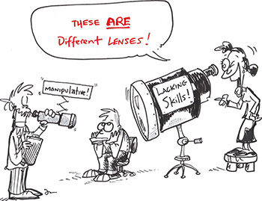
Challenge your thinking

Slide 22
Can’t vs. Won’t
What if…
“He didn’t have the skills to handle his frustration when he was losing a game and he couldn’t keep his emotions together, therefore he threw the pieces on the floor.”
“She didn’t have the skills to say she didn’t understand the directions and she spit and ran away instead?”

Slide 23
Can’t vs. Won’t when we are using CPS vs Common Behavioral Thinking
When we think “won’t” we think “active noncompliance” and we tend to go to “punishment” or “motivation” to change behavior.
When we think “can’t” we think “lagging skills” and we tend to change behavior through “teaching” coupled with “modification of expectations.”

Slide 24
When we adopt the philosophy “Kids do well if they can”
Then we offer a much more compassionate and empathetic view of the child’s world.
Then we offer a teaching model then we are in a place where we can help a child succeed, learn, develop relationships, problem solving, and communication skills.

Slide 25
Logical intervention
Let’s not try to motivate them to do more of the skills they don’t have…if you have a reward system that works you may still use it.
Let’s find out which skills they are lagging in
Then lets teach them the skills
Identify what the unsolved problems are
Identify what triggers the behavior (some will be “out of the blue” many are predictable)

Slide 26
Collaborative Problem Solving Background
If we work on the philosophy that problem behavior is related to a learning disability of inflexible thinking and cognitive processes and that kids do well if they can then….
We need to assess thinking skills NOT behavior
We need to know what is going on in the child’s head that we wish wasn’t?
We need to know what isn’t going on in the child’s head that we wish was.
We need to have goals and a method to teach thinking skills and problem solving.
We need to have parent involvement and understanding of Plan A,B,C and most of all consistent follow-through so the child trusts the process that there will not be imposed plan A.

Slide 27
When you encounter a challenging behavior
Remember
Kids do well if they can…
Behind most challenging behavior is an unsolved problem/trigger and a skills deficit

Slide 28
Collaborative Problem Solving THE APPROACH
1) Complete the Thinking skills Inventory (TSI) with a team
2) Identify Unsolved Problems
3) Identify Triggers – Drill down to get specific
4) Complete the thinking skills assessment – give examples
5) Prioritize the problems you need to solve (level of harm, frequency, successful resolution, how invested is the child in resolution?)
6) Work on Plan B issues, I.D. plan C, Coach parent on elimination of Plan A
7) Using Plan B with strong parental support, the child/family has a reduction of problematic behaviors, the child improves lagging skills, and proactive plans are developed to help engage the child in preventative problem solving before “predictable” problems will occur

Slide 29
Thinking Skills Inventory (TSI) Assessment of Lagging Skills and Unsolved Problems (ALSUP)
http://thinkkids.org/ (Ablon)
Likert scale format, Ablon (TSI) http://thinkkids.org/docs/TSI%2010-09.pdf
http://www.livesinthebalance.org/ (Greene)
Ross Greene Likert scale, ALSUP inventory
http://www.livesinthebalance.org/sites/default/files/ALSUP-Likert-Scale-12-5-08.pdf

Slide 30
Skills Inventory
Whether your child has an ASD diagnosis or not, the skills inventory encompasses “key lagging skills” in many children who are seen in clinics and who are receiving special education services.
Your child may have difficulty with one area or all areas on the inventory.
You child may be mild or severe
Celebrate and utilize your child’s strengths
Build upon the weaknesses

Slide 31
Uses for skill inventory
IEPs great source for goals and objectives
Baseline data for progress monitoring
Identifying potential breakdowns that may be contributors to the meltdowns that you haven’t quite figured out the causes to
The trouble areas will guide your intervention
Share with your community psychologist to guide programming
Share with community providers (OT, PT, SLP, social workers, MDs) to give a profile of strengths and weaknesses that might not be so obvious.

Slide 32
Why do we use this?
It helps the adults understand…
That a child’s behavior is a form of a LEARNING DISABILITY and NOT always intentional, goal oriented, manipulative or for attention-seeking.
Identifies specific cognitive skills that need to be TAUGHT
Why incentive programs haven’t made things better and won’t (outside of basic lessons).
Why your child may need a different approach
Team input, gives good baseline data and good progress monitoring information.

Slide 33
Skills Inventory…complete on your own or better yet; with your child’s professional team
Executive Skills
Language Skills
Emotional Regulation Skills
Cognitive Flexibility Skills
Social Skills
Chances are your child who has an ASD will have problems in ALL areas

Slide 35
Skills Inventory notes…
The more specific you can be with examples the better… “drill down to the heart of the issue”
Meant to be filled out by a TEAM of people and monitored for progress over time
Please DO use standardized assessments to help you fill in the form for strengths/weaknesses
Can medications “assist any areas?” (attention inconsistency, impulsivity, anxiety, sleep) use your child’s team to help figure this out.
Medications cannot…
Teach social skills, cognitive flexibility, transitions, empathy, help a child see the “grays,” teach a child how to articulate what is bothering them
*Operant Systems cannot teach those skills either…CPS can help teach those skills

Slide 39
Before we can learn how to solve problems and teach skills we have to learn the process
There are three plans
Plan A
Plan B
Plan C

Slide 40
The Three Plans
Plan A: Impose adult will
Plan B: Collaborative Problem Solving (should be proactive, but can be used in the “heat of the moment”)
Plan C: Drop it (for now, at least)
Notes:
Remember, just because you have an expectation, doesn’t mean you’re doing Plan A, B, or C.
If expectations become unmet, then you have 3 options: Plan A, B, or C.
Having an expectation and having an unmet expectation are two different things. People often confuse Plan A with expectations, and think that Plan A is having an expectation. It’s NOT! If people get these confused, then people stop having expectations, which is a problem itself.
Your response to unmet expectations leads to Plan A, B, or C.
And, if your expectation is being met, you don’t need Plan A, B, or C, or there’s no problem.

Slide 41
Plan A
Plan A: Impose adult will
(e.g., “No”, “You must”, “You can’t”, “1-2-3”, “I’m the decider”, “Because I said so!”).
What goals are you pursuing:
Pursue your highest priority expectations
Create (or restore) a helping relationship
Identify and teach lagging thinking skills
Durably and collaboratively solve problems (so they don’t keep coming up)
Reduce challenging behavior
Notes:
It is important to note that simply voicing an expectation is not doing Plan A. It is OK to voice expectations!! However, if the child is not responding, Plan A is one possible response to dealing with an unmet expectation, though it is rarely the first choice in the CPS model. Plan A often increases challenging behaviors/episodes. It does the opposite of reducing the behavior; instead, it causes it.
Where Plan A could be a first choice is if in a child is in serious danger of hurting themselves or someone else.
Plan A only means that 1 out of 5 goals of intervention are met (goal: pursue unmet expectation)

Slide 42
Plan C
Plan C: Drop it (for now, at least)
(e.g., “OK”)
What goals are you pursuing:
Pursue your highest priority expectations
Create (or restore) a helping relationship
Identify and teach lagging thinking skills
Durably and collaboratively solve problems (so they don’t keep coming up)
Reduce challenging behavior
Notes:
You might choose to use Plan C to drop a problem if you decide it is not the priority. Using Plan C in itself is not giving in. Giving in is starting with Plan A but then changing to C.
Ask yourself if you really have a problem with the issue. If not, use Plan C.
If you aren’t dealing with that problem and it comes up, use Plan C.
If there’s bigger fish to fry, use Plan C strategically so you can focus on more important problems.
Plan C only means that 1 out of 5 goals of intervention are met (goal: reduce challenging behavior)

Slide 43
Plan B
Plan B: Collaborative Problem Solving
Work towards solving the problem in a mutually satisfactory and realistic manner.
What goals are you pursuing:
Pursue your expectations
Create (or restore) a helping relationship
Identify and teach lagging thinking skills
Durably and collaboratively solve problems
Reduce likelihood of challenging behavior
Notes:
Lagging skills are not taught through plan A or C. Plan B allows you to solve chronic problems and teach lagging thinking skills.
This does not necessarily a compromise or negotiation.

Slide 44
Clearing Up Misconceptions
Plan B does not mean that you do not have expectations, rather it is an approach to unmet, realistic expectations.
Plans A, B, or C aren’t needed unless you have an unmet expectation.
The plans are not a ranking system for expectations; each plan is a distinct way to respond to an unmet expectation.
Plan B is not negotiation.
Plan B is not “picking your battles”, or the average of Plan A and C.
Plan B is not a “technique”; it’s more a way of operating.
Plan B takes much less time than Plan A.

Slide 45
How do you know which plan you are using?
Ask yourself whose concerns are on the table.
If only the adults concerns made the table you are using Plan A.
If both the adult and the youth’s concerns are on the table you are using Plan B.
If only the child’s (youth) concern is on the table you are using Plan C.
What plan is this? “Go clean your room right now!”

Slide 46
Depending on which plan you use, you will have different outcomes…
Plan A: Parent dictates what to do = possible argument, aggression, stand off and could result in restraint, blowout, child harming self or you or running away.
Plan B: Child and parent worked out the problem together
Plan C: You simply dropped your expectation (for right now, there are other “fish to fry”)

Slide 47
Proactive Plan B
WHY?
The child has demonstrated that he/she needs someone to serve as a “tour guide” for navigating problems and regulating emotions.
Over time, teaches the child skills so he/she won’t need help for the rest of his/her life.

Slide 48
Plan B Ingredients
Empathy/Understanding
Define the Problem
Invitation/Brainstorming
*Great fit for Love and Logic Parents and Teachers!

Slide 49
Step 1: Empathy / Understanding
The goal is to gather information to achieve as clear of an understanding of the kid’s concern or perspective about the problem.
It requires “drilling down” and detective work.
Be curious. Your goal is to get the child talking.

Slide 53
Step 1: Empathy/Understand the Child’s Concern
If the child does not have a concern, you can be sure s/he has a perspective.
Empathy ensures that the youth’s concern is on the table.
Solutions are not concerns.
Empathy is not a formality – you are not finished with empathy until you have a clear understanding of the youth’s concern or perspective.

Slide 54
Empathy / Understanding
Proactive B:
Starts with a Neutral Observation
“I’ve noticed that…”
“It looks as if…”
Followed with …”what’s up?” “what going on?” and inquiry to open the door to more information

Slide 55
Tips for communication
Try not to start off with a behavioral observation “I’ve noticed that you’ve been throwing your stuff around your room a lot lately…what’s up?”
Try not to blame or assume
Stick with the facts
Externalize the problem
Use visuals
Keep it basic with as little words as possible
Keep emotions out of it

Slide 56
For kids who are vague or give out little information.
Reflective Listening
Clarifying questions
Am I right that?
I hear you saying…
…is that right?
Sounds like you are saying...
“How so? Why? What’s going on? “How come?
“I don’t quite understand. I’m confused.”
“Can you tell me more about that?”
“What happened when?”

Slide 57
For kids who are confrontational, give the quiet treatment or give out little information.
Educated Guessing
Reassurance
20 questions
Mind if I take a guess
Let me know if I am getting warm
Some other kids I know
I’m not saying no
I’m not saying you have to
I’m not saying you can’t
You are not in trouble
I just want to understand
I know there must be an important reason
I know you are trying hard
I really want your opinion

Slide 58
ASD and perspective
Part of empathy and understanding is listening. Our children who are on the spectrum will have a perspective certainly it will be greatly different from ours. It may be very difficult to even “rationalize” or “justify” their perspective but try to listen. Engaging in an argument at this point will only escalate the situation.
For non-verbal or low-verbal kids, empathy is still important, offer comfort, use visuals, sensory, and “feeling words” supported with visuals.
Love and logic parents use your empathy statements such as, “Oh bummer” “How Sad” etc.

Slide 59
ASD and Step 1
Use of visuals are important at this point.
Thinking bubbles, speaking bubbles, drawings, cartooning etc. are all good ways for the child to express their concerns.
A 5 could make me lose control is another great method to get “concerns” out on the table…especially if you are having a difficult time figuring out triggers.

Slide 60
Step 2: Define the Problem
The goal of this step is to ensure that the adult’s concern or perspective is on the table.
Proactive Plan B language:
“The thing is…”
“My concern is…”
“What’s important to me is…”
Love and logic parents…this should be familiar to you as well.
Continue with visual supports the child already is familiar with.

Slide 61
Step 2: Define the problem
Definition of a problem is:
Two concerns that have yet to be reconciled.
If there are not 2 concerns, there is not a problem.
Adult concerns and youth concerns are EQUAL.
Sometimes adults do not know their concerns either.
Ask yourself as the adult: What’s my/our concern about that? Why do we care about this?

Slide 62
Step 2: Define the Problem
Good adult concerns: health, safety, learning, how behavior is affecting the kid or others.
What if the kid “doesn’t care” about your concern?
He doesn’t have to! He just needs to take it into consideration.
Remember: Solutions are not concerns.
Dueling Solutions = A Power Struggle
The first two ingredients of Plan B are reserved exclusively for concerns.
Notes:
What if the kid doesn’t care about your concern?
It doesn’t matter; the kid doesn’t need to care. They just need to take your concern into account in the process.
The same goes the other way. Staff might not care, but they need to take the kids concern into account.
It’s important to explain this concept to the kid, and then extent it further to suggest that we could find a solution that takes into account both concerns.
The kid will most likely respond to this because their concern will be met with a solution that works for them.
Kid has probably experienced so much Plan A where their concerns were not respected/cared about, so why should they now care?
This is probably one of the first times they have experienced anything other than Plan A.
If your concerns are not specific enough, you will not get good solutions!
Low quality problems equals low quality solutions.

Slide 63
Step 3: Invitation
Goal of this step is to brainstorm solutions together so as to address both concerns.
Make sure the youth knows this is something you are doing WITH him/her rather than TO him/her.
Let the youth know you’re as invested in ensuring that his/her concern is addressed as you are in ensuring that your own concern is addressed.
When the child has ownership in solving the problem they are more likely to be invested in its outcome and have more carryover.

Slide 64
Step 3: Invitation
Should recap the two concerns so as to summarized the problem to be solved.
Starts with: “I wonder if there’s a way that (recap both concerns).…” or “I bet we can think of something that (recap both concerns)….”
Then: “Let’s think of how we can work that out” or “Let’s see if we can solve that problem”.

Slide 65
Kids who have Autism
Problem solving may only be in “logical” ways without consideration of feelings.
Their perspectives may be “way off” or may not be able to take the perspectives of others.
They may not be able to offer out any ideas…you may use the phrase “would you like to hear what other kids have tried?” Or, “here are some suggestions, do any of these work for you?”
They may be “stuck on” their way (one way) of handling the problem…in that case is this a problem that “has to be” solved for safety, danger, or an immediate need or can we wait until they have more flexibility in skills?
Remember work toward “doable” resolutions, praise any “flexibility” in thinking and any ideas offered out.

Slide 66
After the Invitation
Get as many ideas on the table as possible.
There is no such thing as a bad idea!
Combine, expand, modify, and build on ideas.
Don’t judge; evaluate each potential solution with a simple litmus test:
Does it work for you? Does it work for me? Is it doable? Does it bring up any additional concerns?
If the child does not have any ideas, you can suggest some to consider together.
Finish Plan B with an invitation to revisit the problem if the solution doesn’t work.

Slide 67
Problem solving with ASD kids; is the problem really solved?
We have black and white thinkers; it is critical that they understand completely what their “solved problem looks like.”
Use of T charts, rule books (what I can do, can’t do…and gray areas in between)
Contracts, a rule bound child may like the idea of “checking in” on his progress
Writing a newspaper article or cartoon (older children) as a way to capture and reinforce their learning.
Photographs: What does a clean room look like? Would be a concrete visual of a possible resolution.

Slide 68
Proactive B vs Emergency B
Most problems are predictable, especially with ASD kids.
Takes place well before challenging behavior occurs.
Gives you time to plan and think.
Most likely to solve problems durably.
Takes place during the challenging behavior.
Can be used for solving problems when they happen (not as effective).
More useful for crisis and de-escalation.

Slide 69
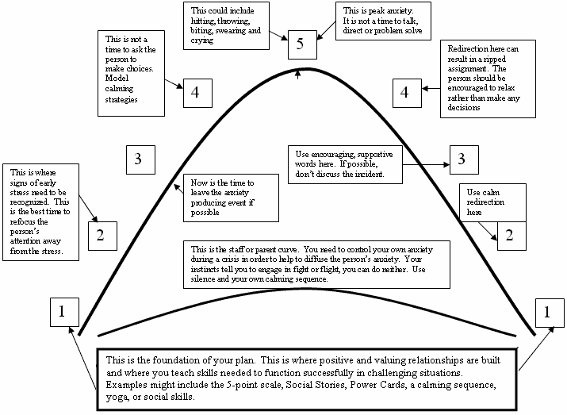
When to use Plan B?

Slide 70
Review of the Plan
Plan B is these three ingredients in this order.
Empathy/Understanding, Define the Problem, Invitation/Brainstorming
History is lots of Plan A, therefore it could take months to lose affective arousal of Plan A.
Explaining why something has to be done is not a part of Plan B.
Remember to talk about what the plan is if the solution does not solve the problem.

Slide 71
Teachable Moments

Slide 72
STEPS
Complete TSI
Identify triggers on TSI
Rank problems and decide which will be Plan B or Plan C (eliminate A)
Decide 1 problem to work on (see TSI to rank)
Step 1: Empathy: Get Child’s concern
Step 2: Define problem: Get Adult’s concern
Step 3: Invitation: generate solutions
Choose 1 Solution and implement it
Decide if it worked or not
Next steps…restart process if problem persists.

Slide 73
How are we teaching our kids skills through CPS?
Many skills are taught implicitly (indirectly) when solving problems using Plan B.
Empathy/Understanding trains identifying, clarifying, and expressing concerns, separating affect.
Define the Problem trains taking another’s perspective, recognizing impact on others, and how one comes across, empathy.
Invitation/Brainstorming trains generation of solutions, anticipating and considering likely outcomes, moving off of original idea.
The entire proactive process trains organized, reflective, flexible thinking and problem solving.

Slide 74
CPS works for kids, parents, & systems too!
The bad news: adults have lagging skills too!
The good news: adults’ initial attempts at Plan B usually reveal what skills they lack.
Every time adults try Plan B they are practicing many skills too.
You CAN’T Plan A your child’s school or your work into using CPS however…try a Plan B approach!

Slide 75
“Sometimes I think the collaborative process would work better without you.”

Slide 76
Developmental Readiness
At what age can you start using Plan B?
A normally developing 3 year old has the skills necessary to fully participate in Plan B.
If the child does not have the skills of a normally developing 3 year old, you’ll need to identify which specific lagging skills (likely linguistic skills) are preventing Plan B from getting off the ground and concentrate on those first.

Slide 77
CPS in Schools
Can Plan B be implemented in an entire classroom or group?
Key themes:
“Fair does not mean equal”.
“In our classroom/group:
Everyone’s working on something.
Everyone gets what they need.
We do different things for different people.
We help each other”.
Best to have the teacher/aid who the concern is directly involved with use the model…do not “send the child out” for processing with somebody else.

Slide 78
Convincing Others
What do I say to help my colleagues move in this direction?
Pragmatism:
What we’ve been doing isn’t working or is it? (see research on website on reward/punishment)
Reward and punishment programs don’t teach skills. (Only basic ones like right and wrong)
Time (how much time spent on behavior)
See research on this program and seclusion and restraint
Research documenting challenging behavior as a developmental delay and the effectiveness of the model.

Slide 79
CPS links
http://www.thinkkids.org/
www.explosivechild.com
www.explosivekids.org/index.html
http://www.livesinthebalance.org
Reading
Treating Explosive Kids: The Collaborative Problem Solving Approach
By: Ross. W. Greene, Ph.D. and J. Stuart Ablon, Ph.D.
The Explosive Child
By: Ross W. Greene, Ph.D.
Lost At School
By: Ross W. Greene, Ph.D.

Slide 80
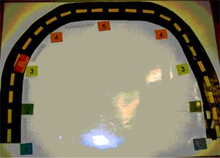
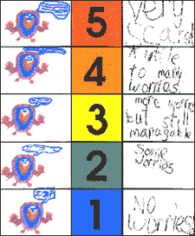
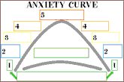
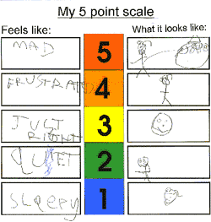
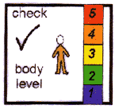

Slide 81
Visual Supports
Aid in problem identification
Trigger identification
Assist in problem solving
Assist in self-regulation
Teaching tools –surrogate frontal lobe
*Great resources already made at Do2Learn.com

Slide 82
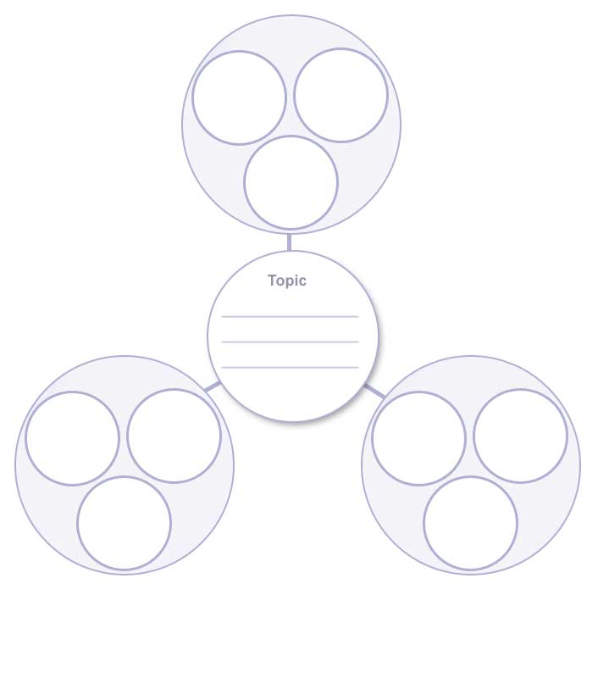
Potential
solutions
Problem
Plan B resolution
Child
Concerns
Parent
concerns

Slide 83
Identifying triggers: what makes me feel upset.

Slide 84
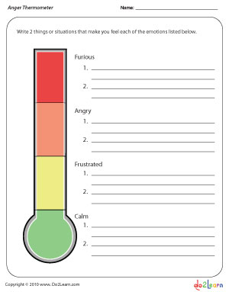
Identifying triggers: what makes me feel upset.

Slide 85
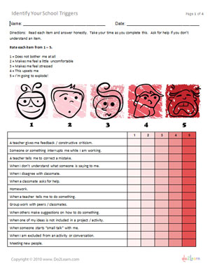
School Triggers
Inventory
Do2learn.com

Slide 86
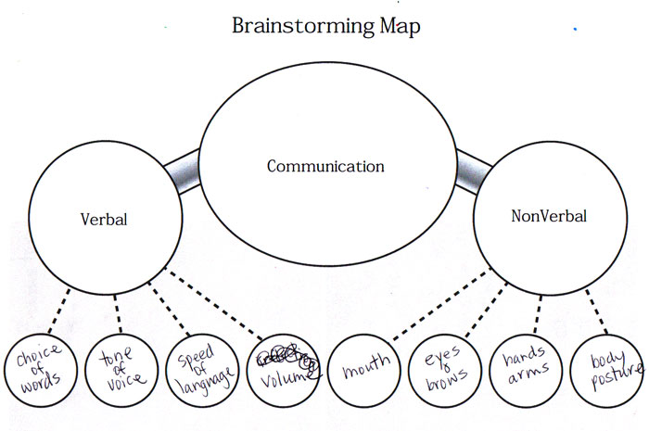
Unsolved Problem
Child Concern
Adult Concern
Plan B – Mutually
Agreeable resolution
Potential solutions
Potential solutions

Slide 87
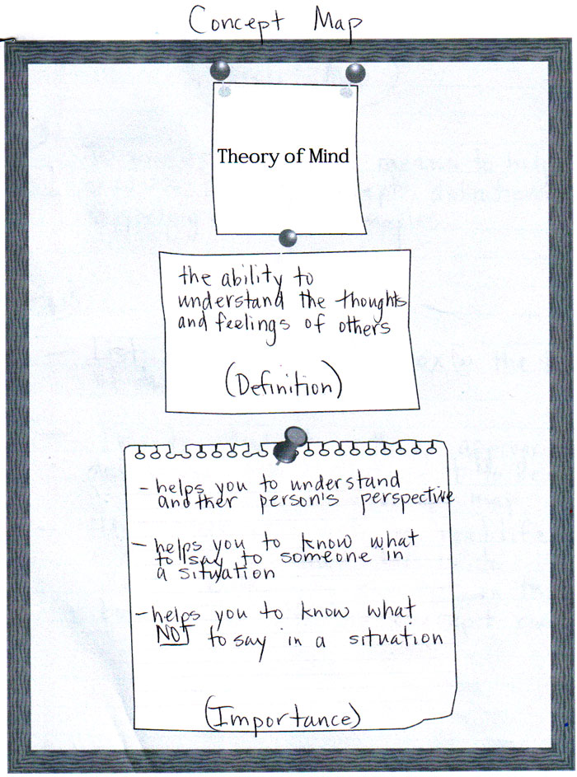
Breaking
Down a
problem –
the Drill Down.
Problem
Drill down
The
Heart
Of the
problem

Slide 88
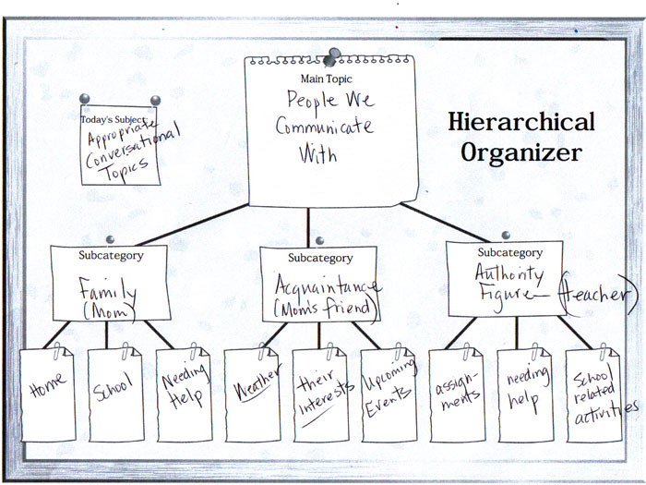
Taking a big problem and breaking it down:
Lagging Skills
Problem
Mutual Agreement
Child’s concerns
Parent’s concerns

Slide 89
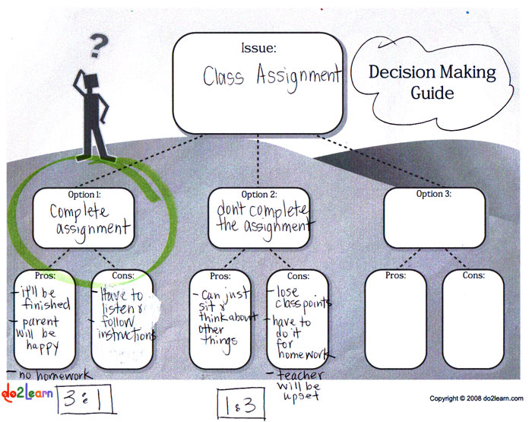
Putting concerns out there and coming to agreeable resolution.
Mutual agreement
Reinforce
Perspective
taking

Slide 90
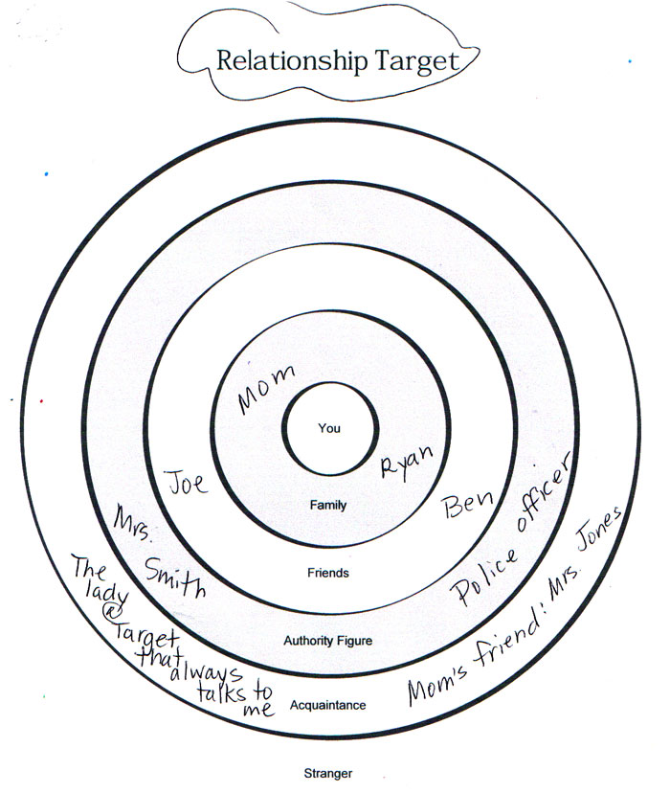
Fun one!
For the child who is quiet or hard to get information
from you can
Play 20 questions,
Bulls eye, am I
Getting hotter?

Slide 91
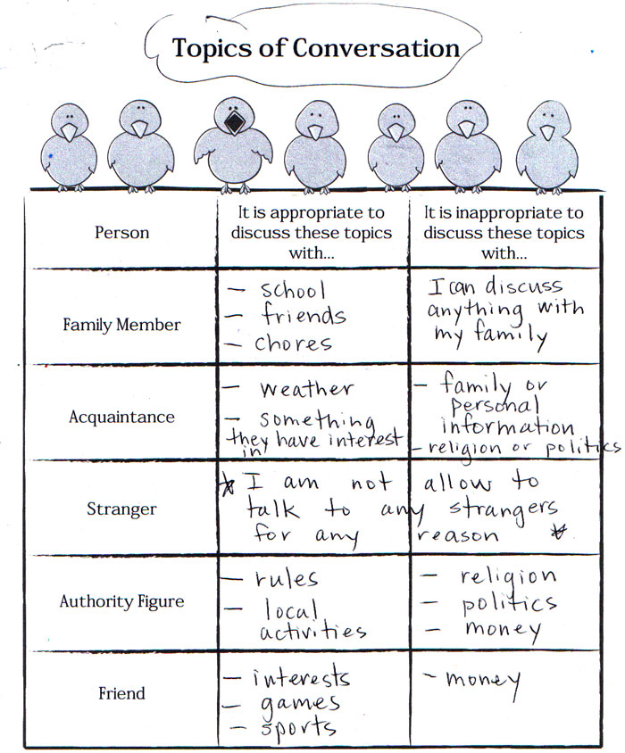
T Chart format
Child’s Concerns
On left and
Parent concerns
On the right.
T charts are good
For also teaching
Rules…it is ok to
Do X but it is not
Ok to do Y.

Slide 92
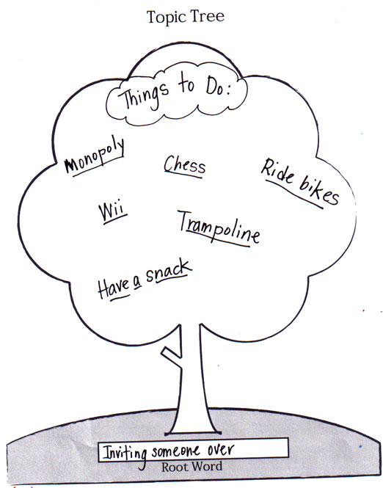
To help a child
Brainstorm solutions
To a problem instead of
Them saying “ I don’t
Know?”
Both child and parent
Fill out a tree then decide a way to solve the problem.
You could draw instead of write.
Any possible ways to solve the problem
Problem

Slide 93
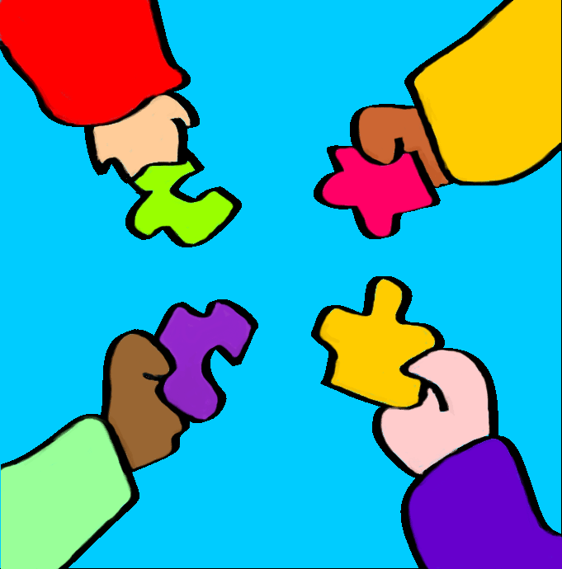
Thank You!
Diane Durante, MEPD, OTR, CST I
Occupational Therapist
D.C. Everest Area School District
715-241-9700 ext. 2304

